Slide 1

Building a High Performing Remote Team so You Can Go on Vacation
John Kuefler

Slide 2


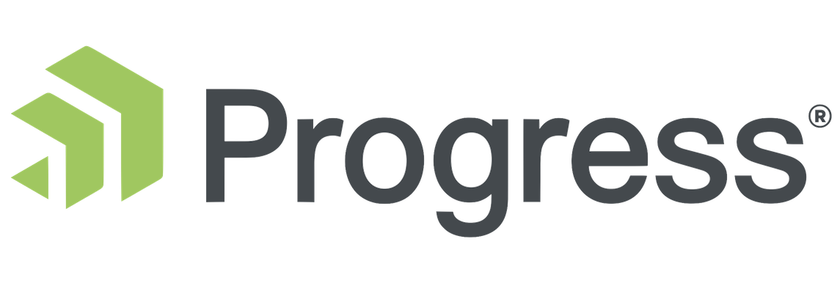













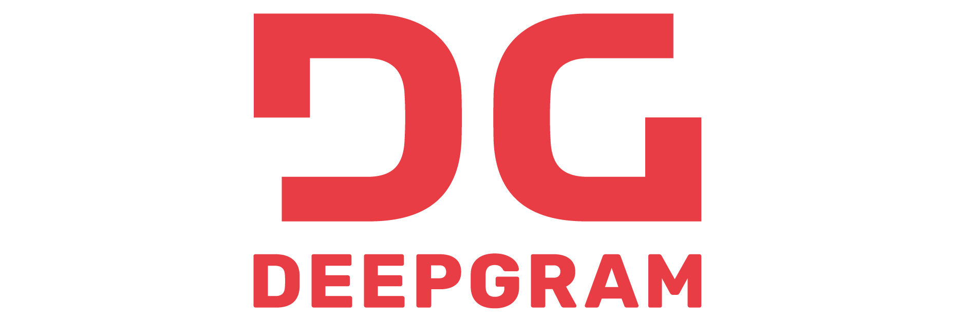







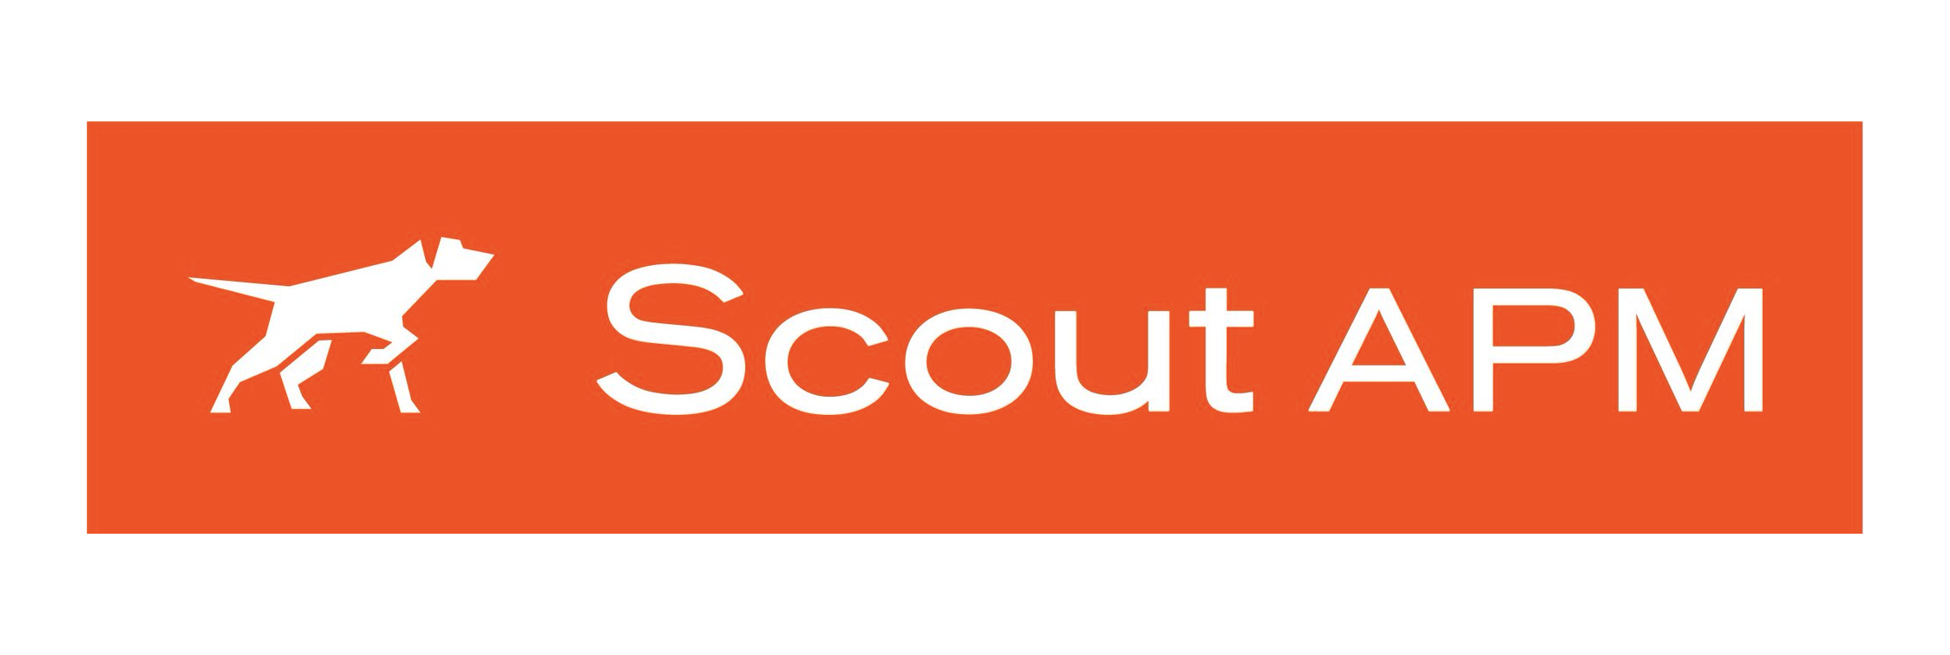




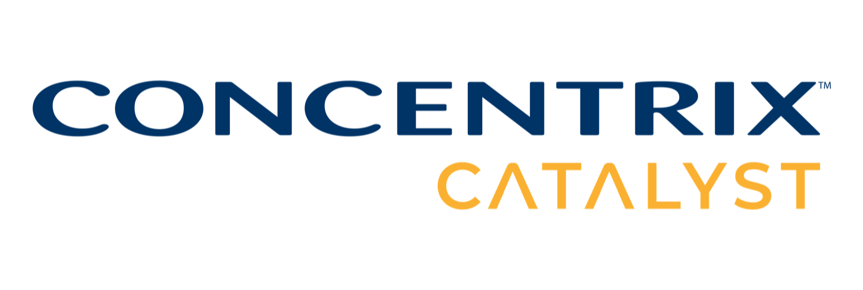

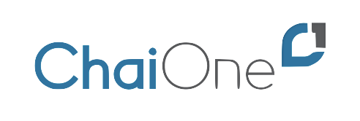













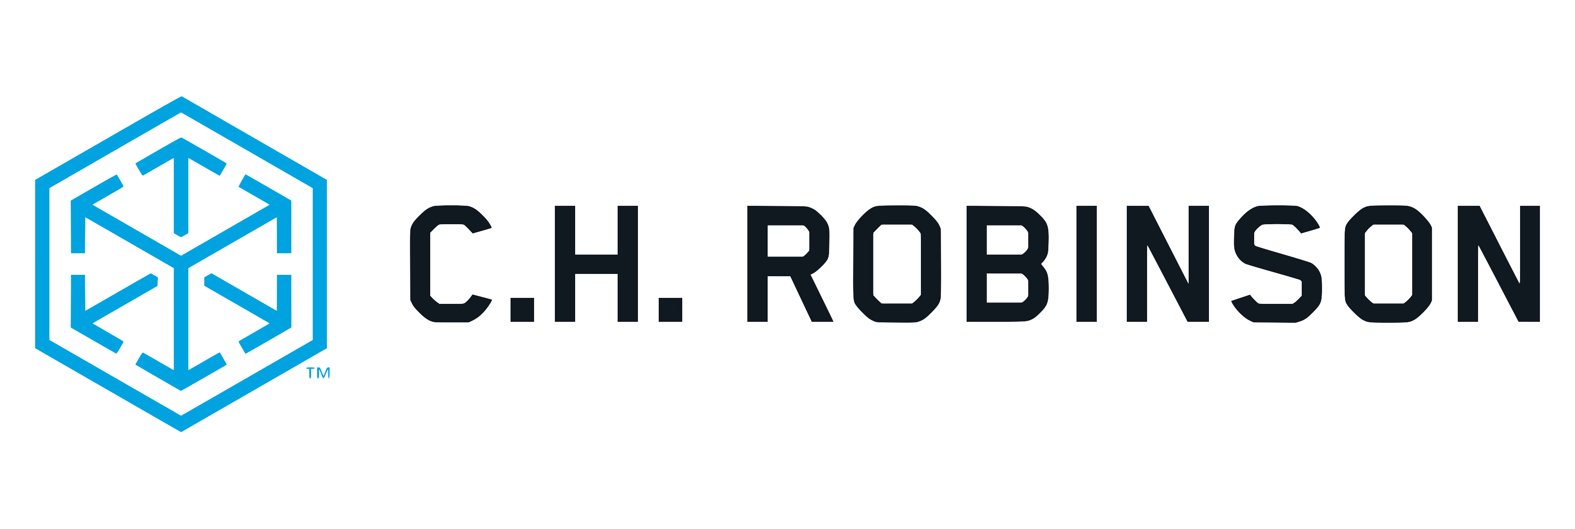






Titanium Sponsors
Speaker Dinner Sponsor
Platinum Sponsors
Gold Sponsors

Slide 3
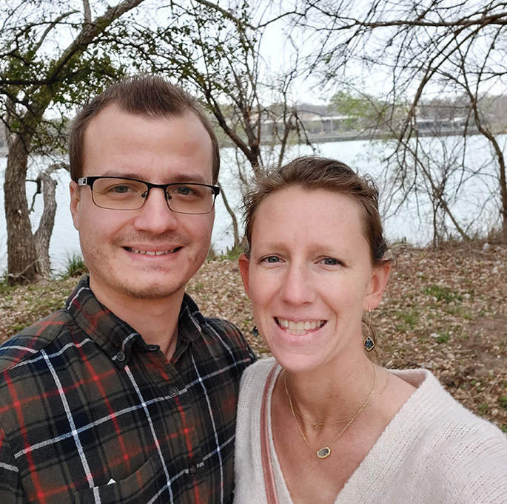
About Me
Director of Technology & Operations, Partner, LimeLight Marketing
Associate Instructional Professor, Pittsburg State University
Pluralsight Author
K-12 Programming Curriculum Developer/Advocate
Uber Driver
Email: john.kuefler@limelightmarketing.com
Twitter: @john_kuefler91

Slide 4

Agenda
Going on vacation is important
Remote work facts
Delegating better
Leadership vs management
Team structure theory
Building the right culture

Slide 5

Going on vacation is important
…actually disconnecting even moreso
Notes:
One new benefit being offered – a week of PTO at the beginning of a new job to recharge

Slide 6
Going on Vacation is Important
If you manage a team, and you can’t go on vacation, something is wrong
As it turns out, the goal of wanting to go on vacation aligns well to what you need to do to build a good team – build autonomous, high functioning team members
This is true whether your team is remote, or in person
Bad signs to look out for:
I feel too guilty to go on vacation
I’m too tired to go on vacation
I’ll just get bothered the whole time I’m on vacation
Something will go wrong if I’m not there

Slide 7

Remote Work as an Option is the Future
The debate on remote work is over. If you’re still having it, you’re going to bet left far, far behind soon.
Of course, this debate is applicable to jobs that can be worked remotely.
To go on vacation, you need a high performing team. To get the highest performing team possible, you need to be open to some or all of them being remote.
Not everyone likes to work remotely, and that’s ok too.

Slide 8

Remote Work - Let’s look at the numbers
16% of companies in the world are 100% remote.
44% of companies don’t allow remote work.
Better work-life balance is the main reason why people choose to work remotely.
77% of remote workers say they’re more productive when working from home.
The average annual income of remote workers is $4,000 higher than that of other workers.
85% of managers believe that having teams with remote workers will become the new norm.
74% of workers say that having the option to work remotely would make them less likely to leave a company.
The three biggest challenges associated with remote work are unplugging after work (22%), loneliness (19%), and communication / collaboration (17%).
https://findstack.com/remote-work-statistics/

Slide 9
Remote work and flexibility
Flexibility is a key reason that remote work is preferred by many
Flexibility means a lot of things to a lot of people
The ability to run to school to drop my kids off or pick them up from activities
The ability to log off an hour early some days so I don’t need to hire a babysitter, and log on later that night to finish my work
The ability to get a little extra sleep in the morning
The ability to work in any type of environment I want (home office, outside, coffee shop, etc.)
The ability to be at home with my family more
As long as people get their work done and attend meetings on time, is any of this a problem?

Slide 10

Boundaries are Critical
One of the three biggest challenges associated with remote work is unplugging after work (22%)
Offices provide natural geographical boundaries between us and our work
It’s very important to building a highly effective remote team to encourage them to have healthy boundaries with work, and to not take advantage of the fact that they are plugged in all the time
We’re even seeing regulation around that second part in some parts of Europe at this point

Slide 11
Accountability is Critical Too
Being accountable as a worker and holding your team accountable as a manager.
Expectation setting is key
There still have to be reasonable expectations from all parties around the amount of work that is going to be done.
Let’s not be those people that give remote work a bad name….
https://www.distractify.com/p/remote-employee-full-day-30-minutes
https://news.yahoo.com/visibly-frustrated-mark-zuckerberg-responds-172521137.html

Slide 12
Delegating
As a manager, if you don’t delegate properly, your team won’t succeed, and you can’t go on vacation.
What is delegating?
A remote team forces us to delegate better!

Slide 13

Why is delegating hard?

Slide 14
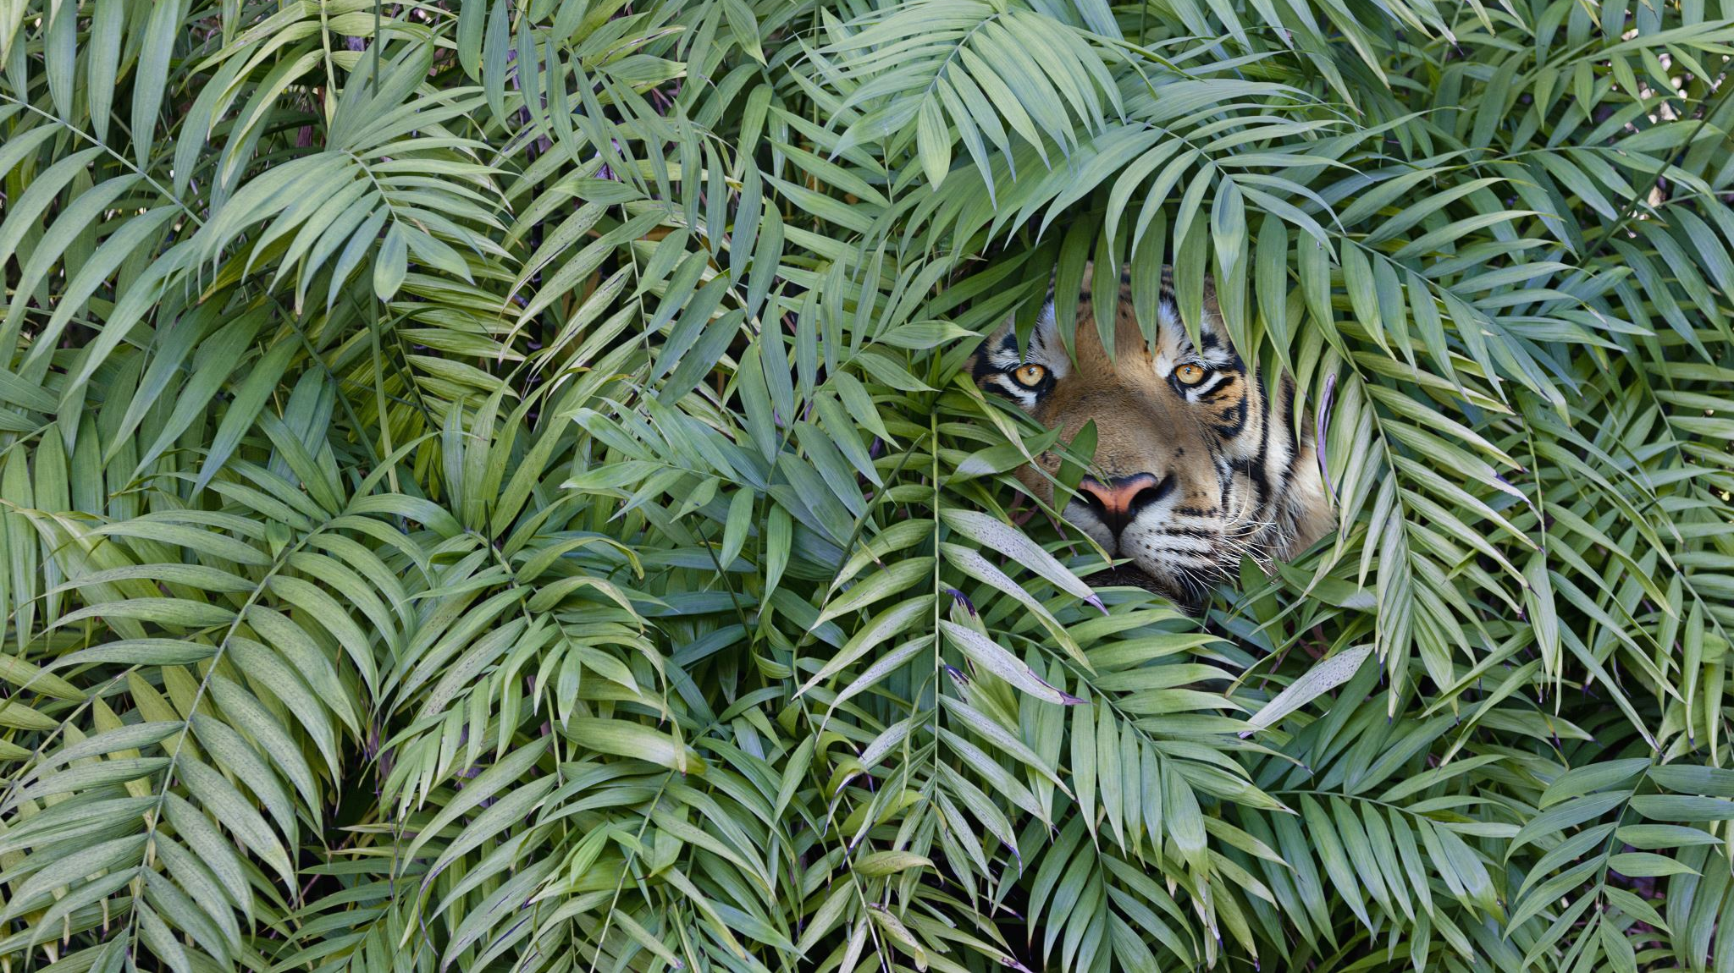
Fear

Slide 15

Assumptions

Slide 16

Laziness*

Slide 17
Tell me and I’ll forget
Show me and I may remember
Involve me and I’ll understand
- Ben Franklin

Slide 18

Team structure is important

Slide 19
Progressions of Employees
Here is the progression that everyone on your team will go through:
Expert
Apprentice
Helper
Peer Mentor
Doer
Manager
Intern
Leader

Slide 20
My Ideal Team Makeup
Keep your team balanced. If you notice problems on your team, think about your team’s balance. Don’t over-staff types you’re weak to manage.
Apprentice or Intern
Doer
Peer Mentor/Expert
Leader
Helper
Doer
Manager
Doer

Slide 21

Management vs Leadership

Slide 22

Enable Bright Spots
To empower your team overall, you must empower other leaders on your team.
Great technical performers are not always great managers and leaders. In fact – often the opposite. Let good doers be good doers. Elevate them into positions of higher level doing.
Don’t be content to just get the work done. Always be looking for and empowering the next leader.
Notes:
Example - Sara

Slide 23

Keeping the Best Talent
According to Cella’s 2021 Talent / Jobs Survey for creative/digital/marketing workforce:
Half of respondents say they’re thinking of leaving their organization behind
41% plan to leave because of:
Lack of desired compensation
Feeling uninspired and not challenged enough
No career advancement opportunity
Absence of professional development
Over 50% resigned past jobs due to poor leadership or toxic environments

Slide 24
Building the right culture
Building the right culture for remote work can be hard, and there’s differences in how to do it for purely remote vs hybrid remote
“What if people don’t get their work done because I can’t see them doing it” is an attitude to avoid
Studies have shown people are *often MORE productive working remotely. A bad employee is a bad employee, in the office or remotely.
Companies end up being surprised when they take the leap at the productivity boost.

Slide 25
Building the right culture
If You are Hybrid remote:
Bring the whole team together digitally often
Make digital meetings the standard, even if some people in each meeting could meet in person
Define the right boundaries between video, chat, and email for communication (you must have all 3)

Slide 26


Slide 27
Question: What are barriers to remote work or reasons not to do it that you’ve heard in the past?

Slide 28
Question: What about a 4-day work week?

